Slide 1

Orario
A Web-Based Multi-Tenant Scheduling Solution
YCL2502_CSCI4998 Final Year Project I By: To Chi Keung (1155193190)
Wong Ho Yan(1155193353)
Supervisor: Dr. LAW Yat Chiu

Slide 2
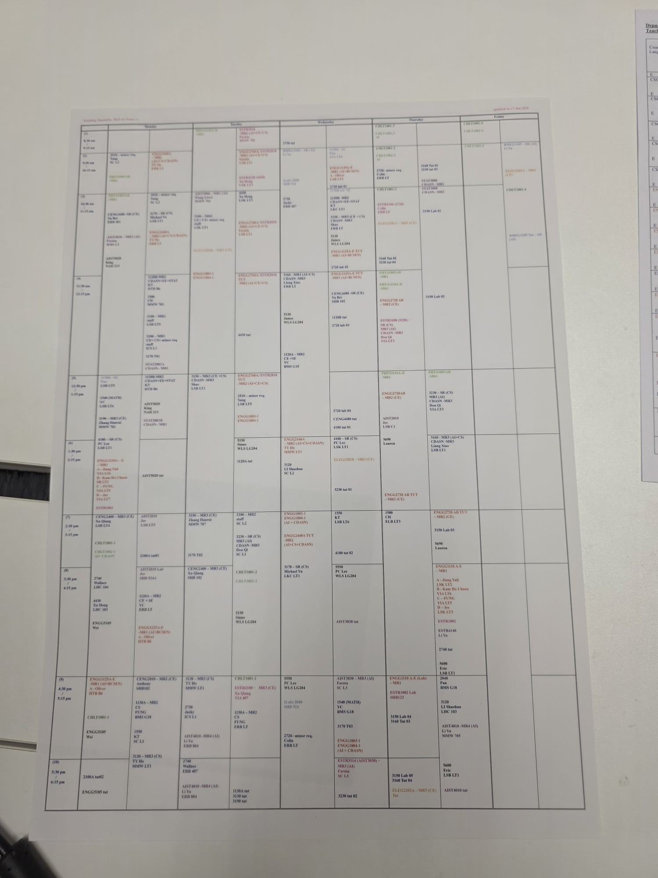
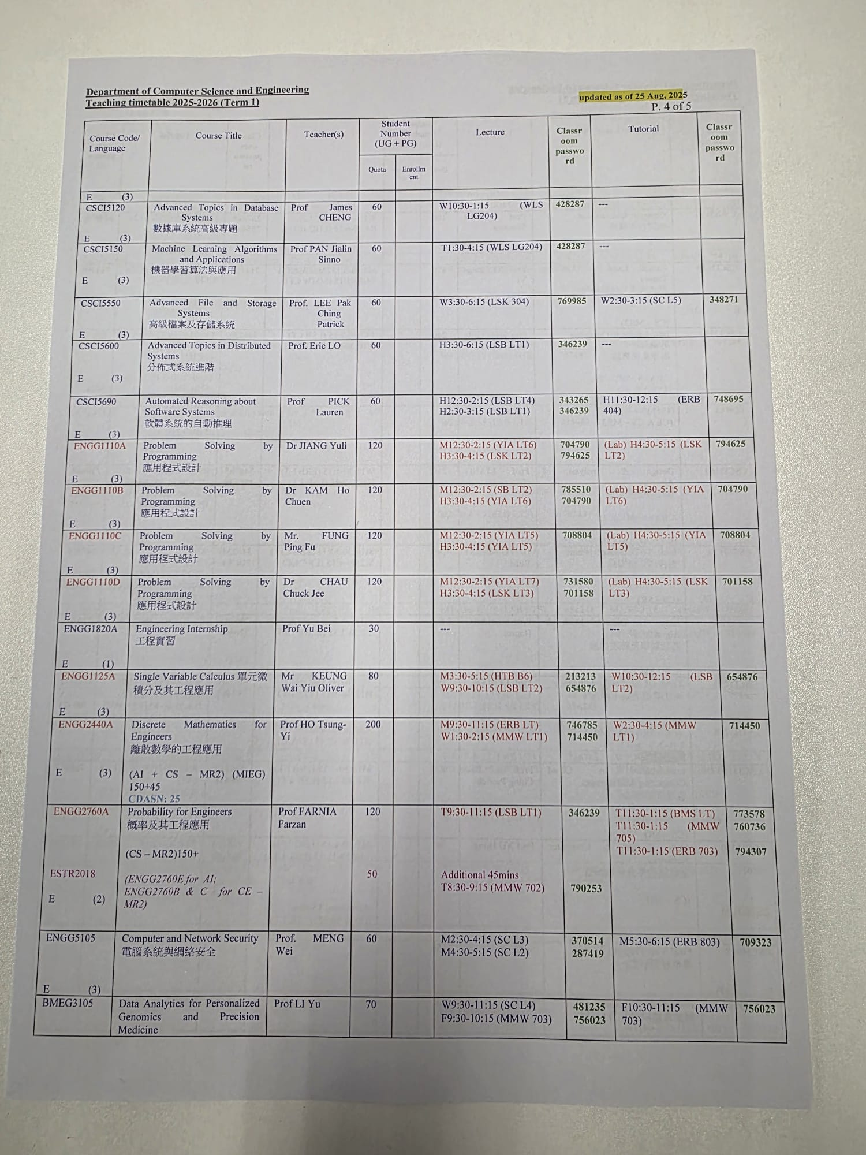
The Problem: Scheduling Dilemma
Administrative Bottleneck
Data Integrity Risks
Notes:
The left image is the timetable of courses offered by CSE department in the current semester, the right one is the course list.
These are all done manually, in excel.
Data Integrity: Spreadsheets lack the referential integrity to see these 'Silent Failures.’
Algorithmic Complexity: Our department manages curricula for 4 different Majors (CS, CE, AIST, CDS). Humans simply cannot calculate hundreds of cohort combinations against every time slot to prevent these clashes.

Slide 3
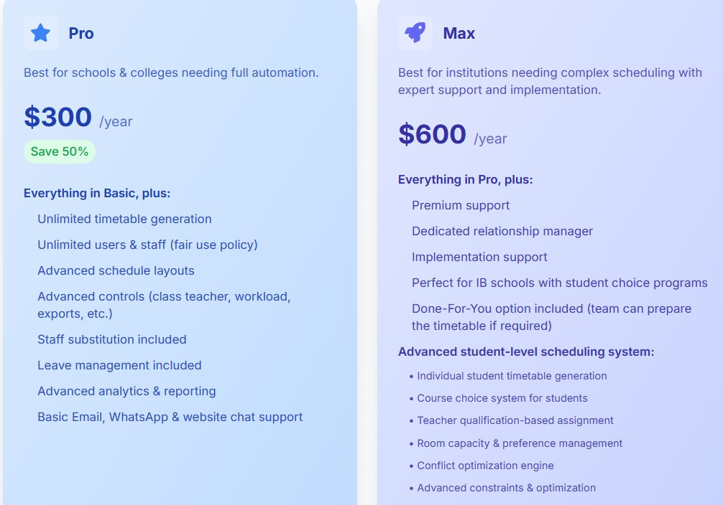
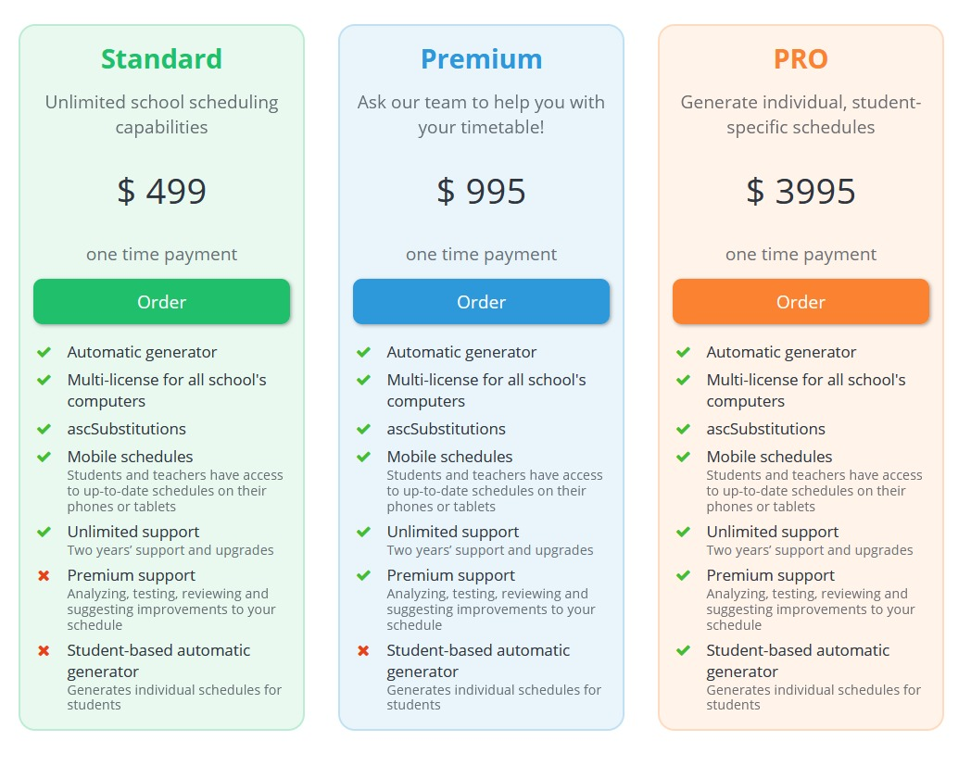
The Problem: Scheduling Dilemma
Cost vs. Value
https://www.timetablemaster.com/pricing
https://www.asctimetables.com/a/prices/pricing
Notes:
Currently, there exist timetable products online but they are way too expensive and generic. They cannot meet our department’s requirement in scheduling.
These are the first two course scheduling product appears in Google search result.
For the left, it requires 600 USD per year to get the full services.
Although the right one is a one-time purchase, which cost 400USD, it’s specified for primary and secondary schools.
Both cannot handle the complexity and constraints of the CSE departments in scheduling.

Slide 4
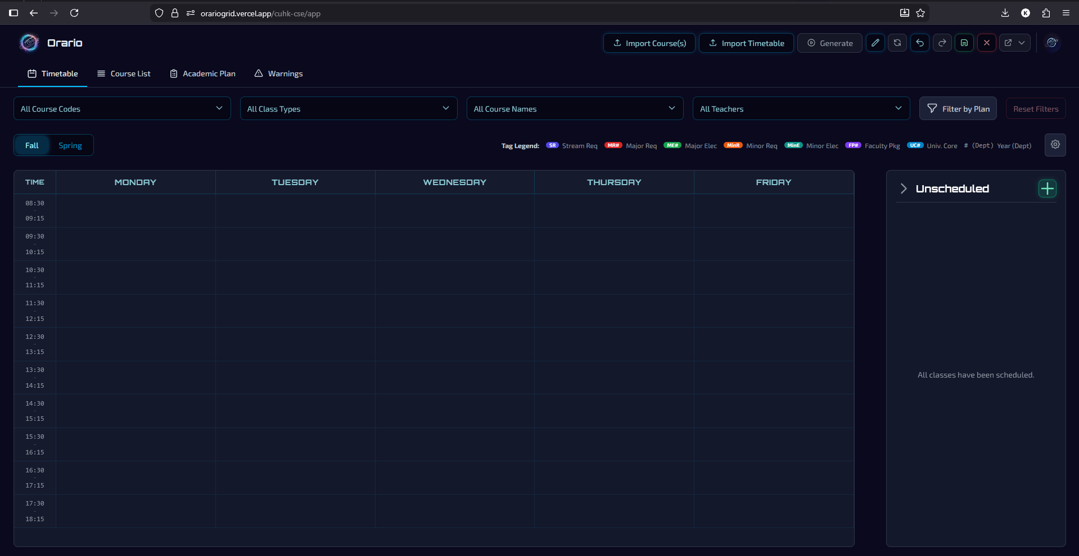
Our Solution: Orario
Notes:
To solve these challenges, we built Orario, which is completely free for our department.
Orario is not just a digital calendar; it is a Domain-Specific Scheduling Platform designed to bridge the gap between manual spreadsheets and expensive enterprise software.

Slide 5
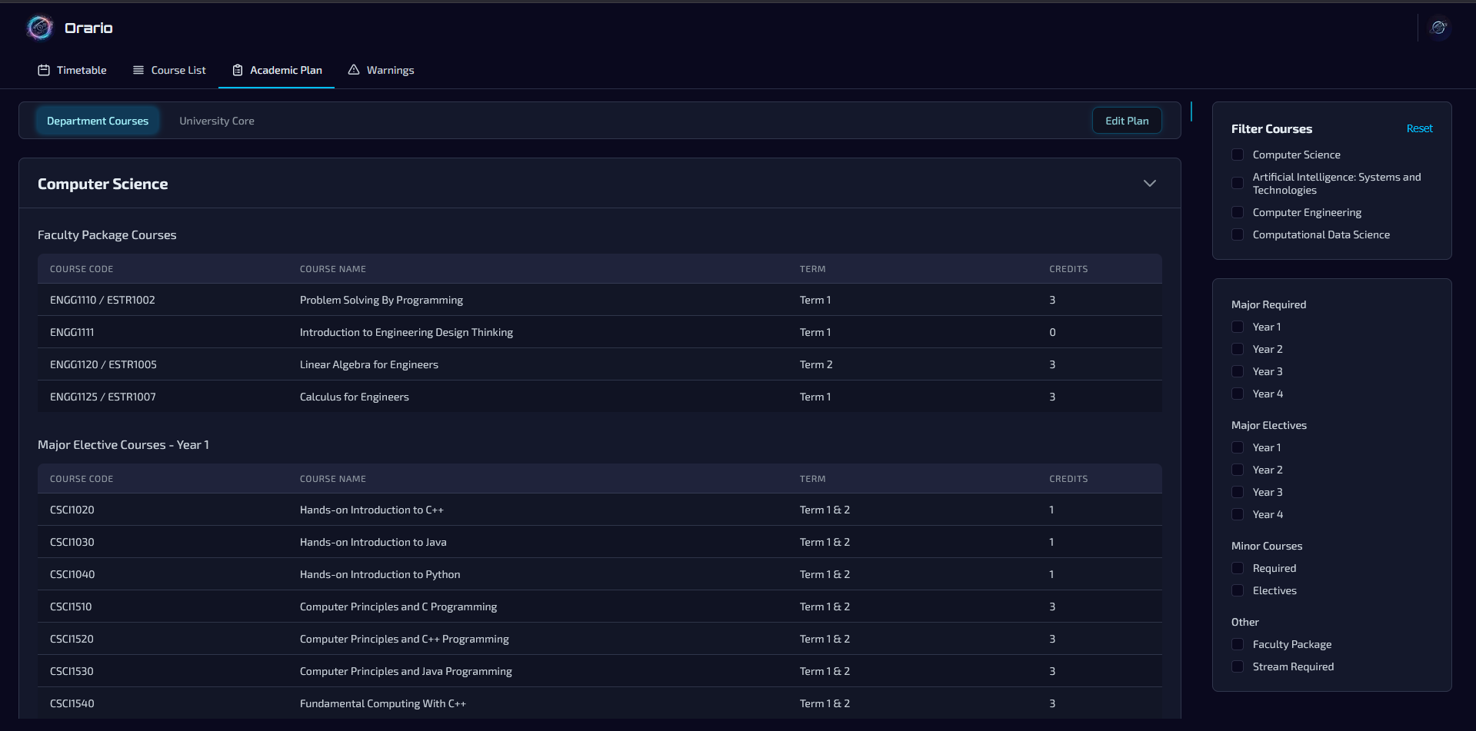
Our Solution: Orario
CSE specific constraints
Notes:
Orario has the curriculums of the 4 majors offered by our department in the system.

Slide 6
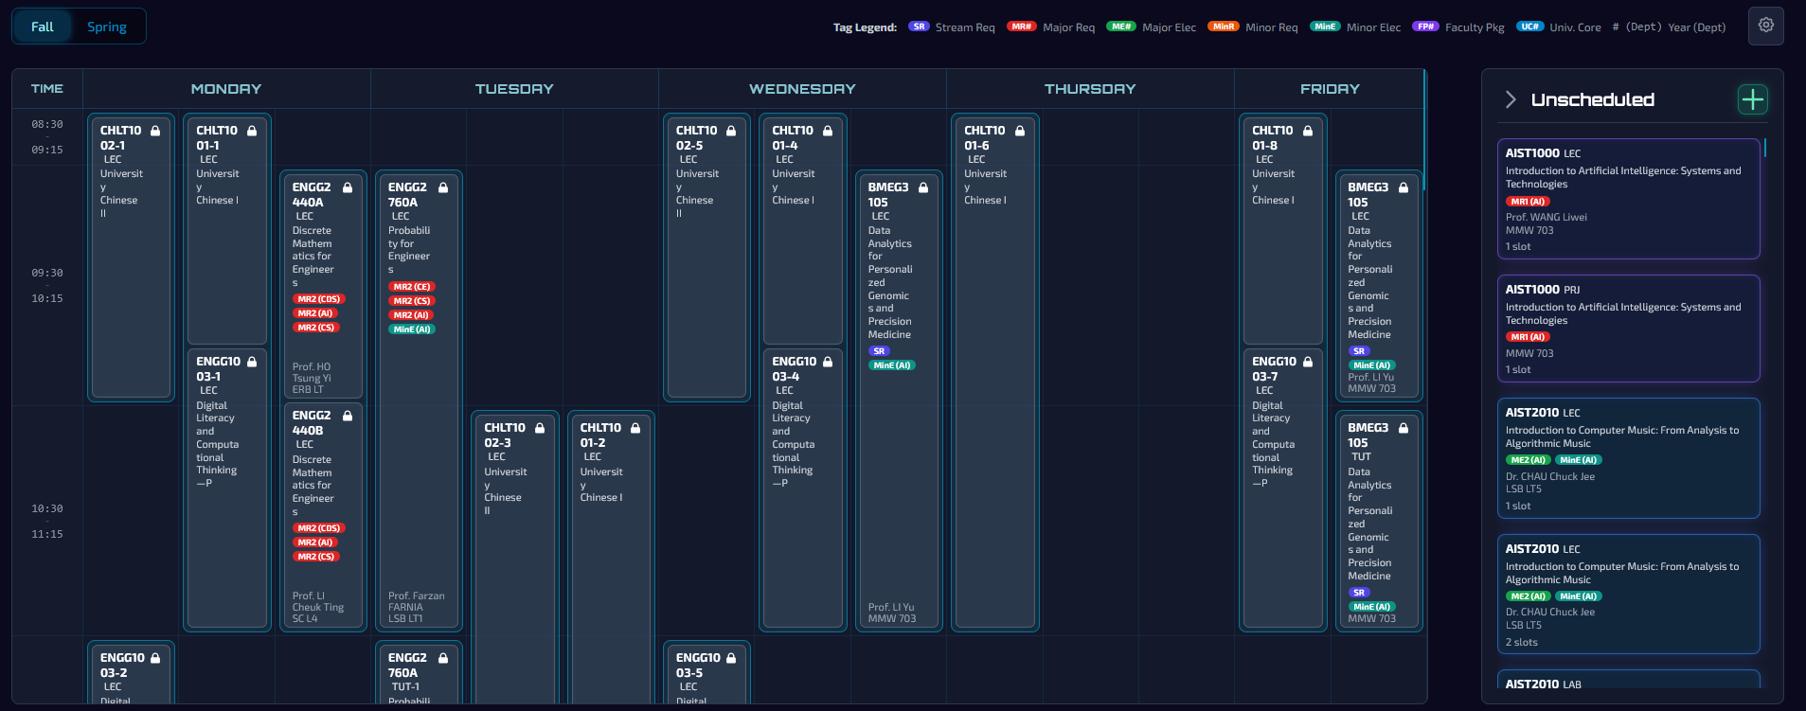
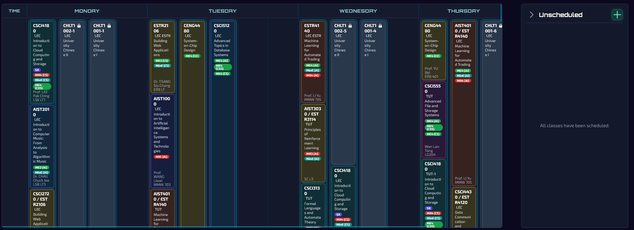
Our Solution: Orario
Automated Intelligence
Notes:
The scheduling tasks of our department is very complex and time consuming. Instead of relying on human intuition, we implemented automatic scheduling. It automatically solves the combinatorial puzzle, from fundamental hard constraints like teacher and single course conflicts, to possible collisions in major required, electives, and university core courses.

Slide 7
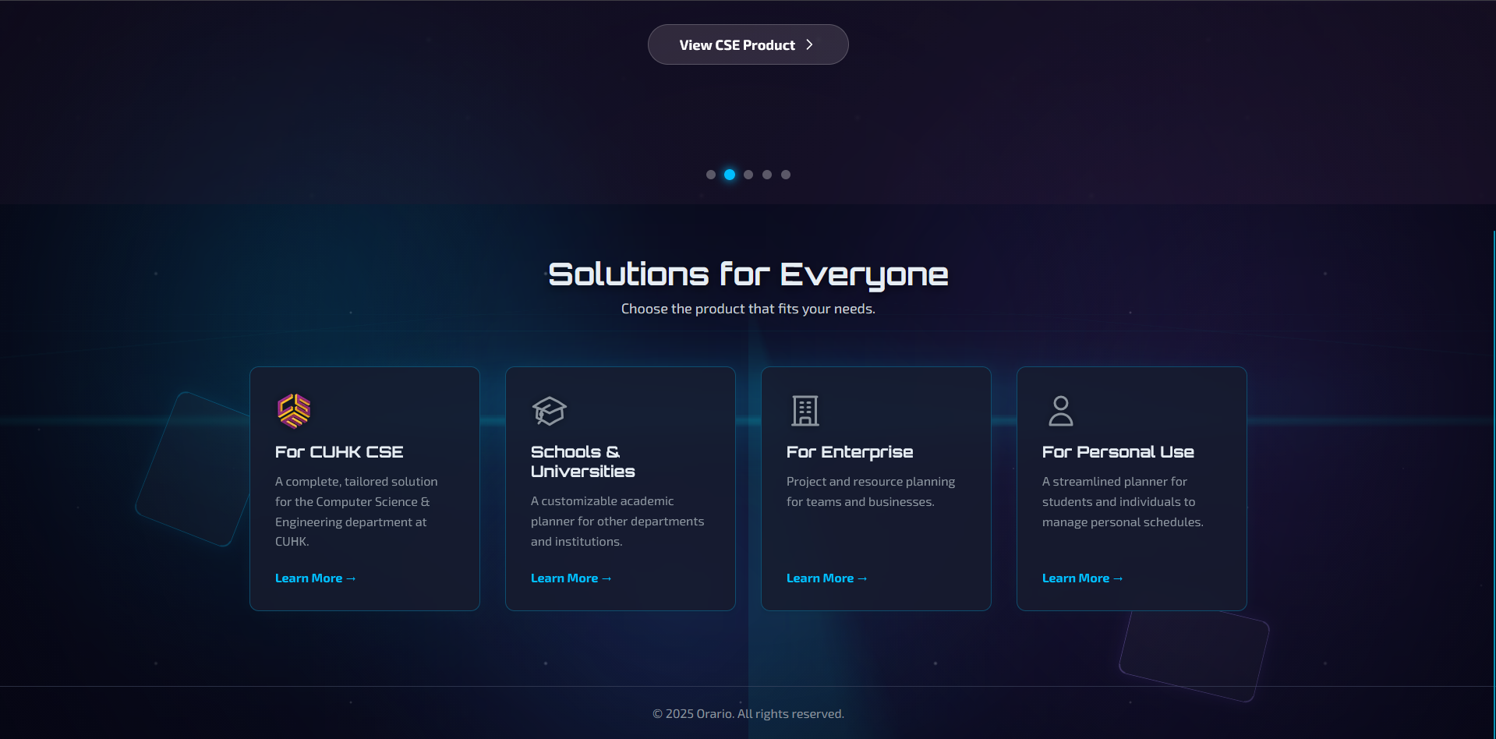
Our Solution: Orario
Scalable Architecture
Notes:
In addition, we built this as a Multi-Tenant web application to meet the needs of scheduling for different parties. This means while it is tailored for CSE today, the architecture is ready to serve other departments, institutions, or even individuals and enterprises tomorrow with strict data isolation.

Slide 8
Technical Stack
Frontend
Next.js 14 & React 18
CSS Modules
Key Library: pdfmake, xlsx
Database
PostgreSQL (via Neon serverless)
Prisma ORM
Language
TypeScript (strict typing)
Security & Infrastructure
Clerk (Authentication)
Vercel (Edge Network)
8
Notes:
To build a system capable of handling this complexity, we chose a stack focused on Type Safety and Relational Integrity
The entire project is built in TypeScript since the scheduling algorithms rely on complex, nested data structures. By enforcing strict static typing, we catch logic errors at compile time, ensuring the scheduler doesn't crash when processing thousands of time slots.
For database, we chose PostgreSQL, which is the most popular open-source DBMS. We manage our data via Prisma ORM to ensure our database schema and our frontend types are always 100% in sync.
We utilize Next.js 14, developed by Vercel. This allows a hybrid architecture. We use Server Components to securely fetch data behind the firewall, and Client Components to render the high-performance, interactive Drag-and-Drop grid you see in the browser.
Finally, Clerk handles our Authentication. Crucially, we use Clerk's Organization feature to enforce Multi-Tenancy.

Slide 9
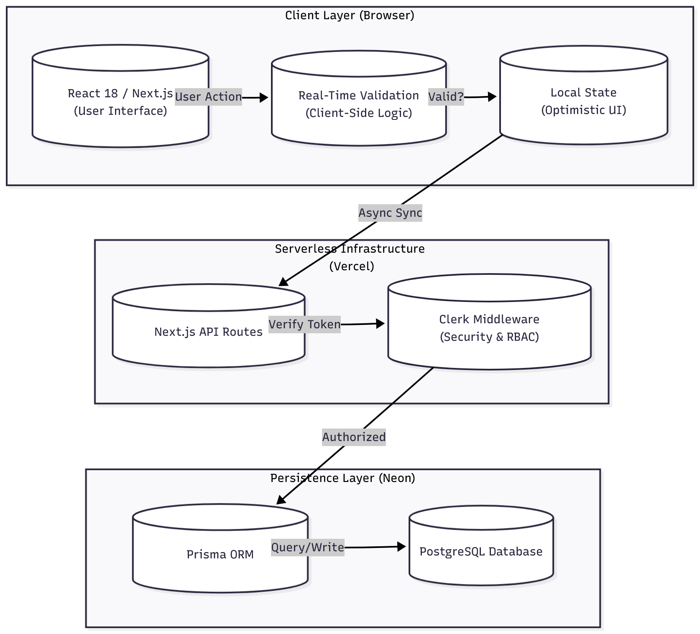
System Architecture
Cloud-Native & Serverless
Strict Multi-Tenancy
Hybrid State Management
9

Slide 10
Intelligent Data Ingestion & Sanitization
Security & Access Control
Automated Scheduling Engine
Core Feature
Safeguards & Output
Interactive Workspace & Real-Time Logic

Slide 11
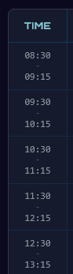
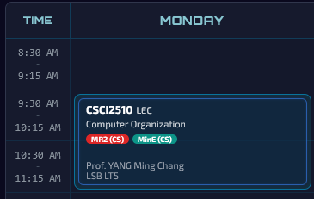
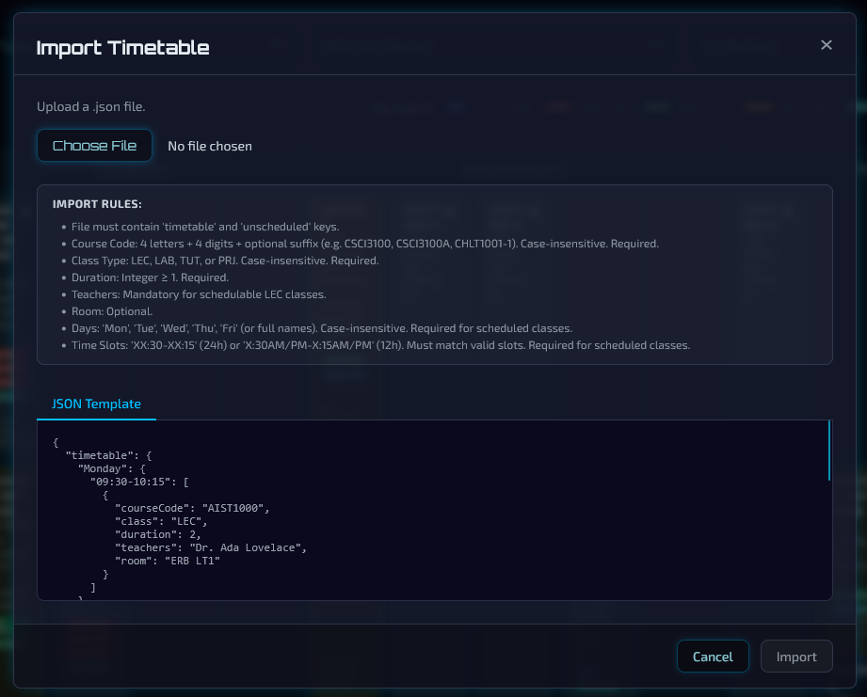
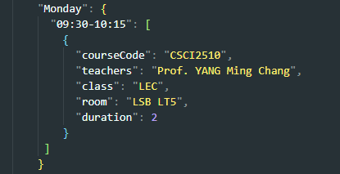
Intelligent Data Ingestion & Sanitization
Schema Validation
Time Formats

Slide 12
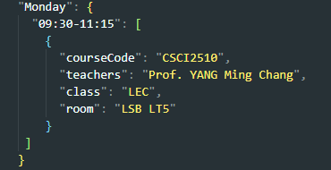
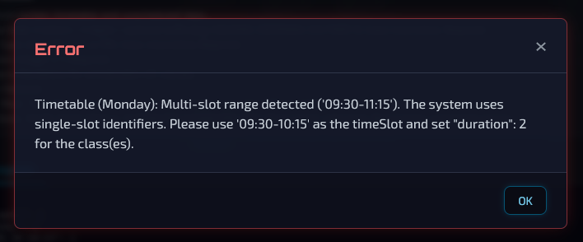
Intelligent Data Ingestion & Sanitization
Schema Validation
Time Formats

Slide 13
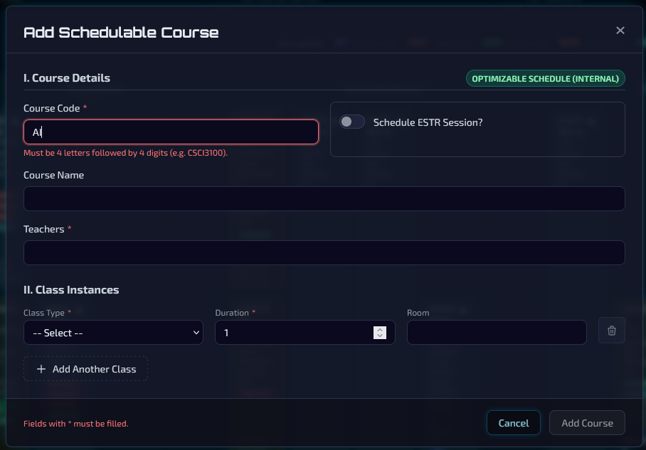
Intelligent Data Ingestion & Sanitization
Schema Validation
Course Codes

Slide 14
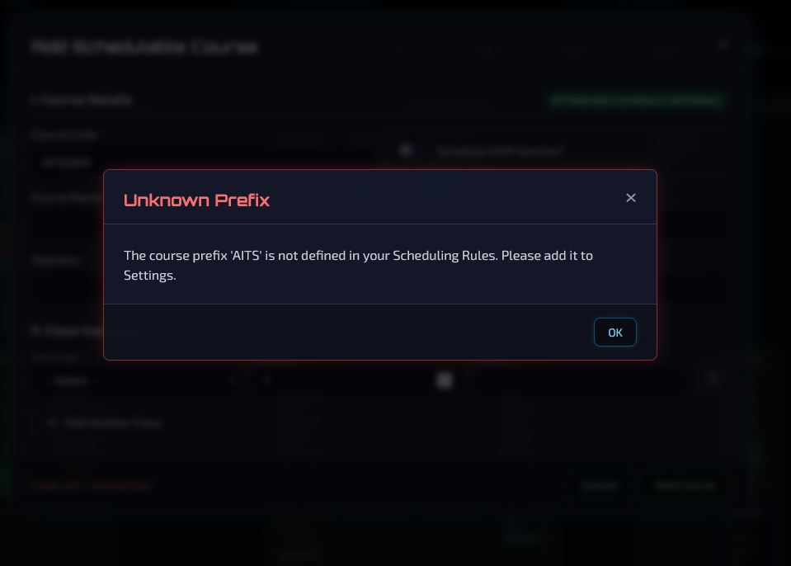
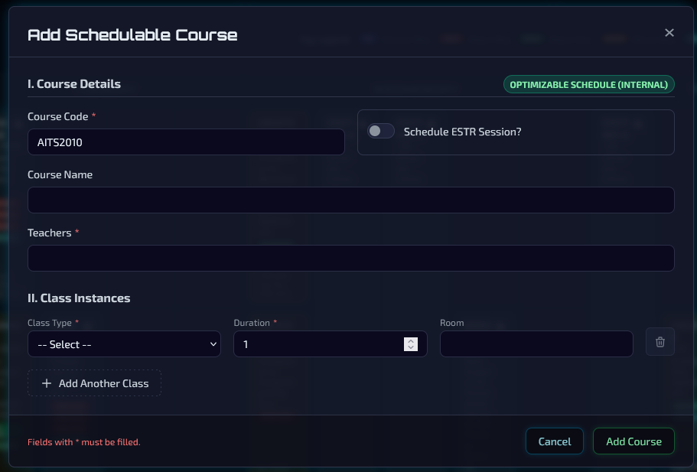
Intelligent Data Ingestion & Sanitization
Schema Validation
Course Codes

Slide 15
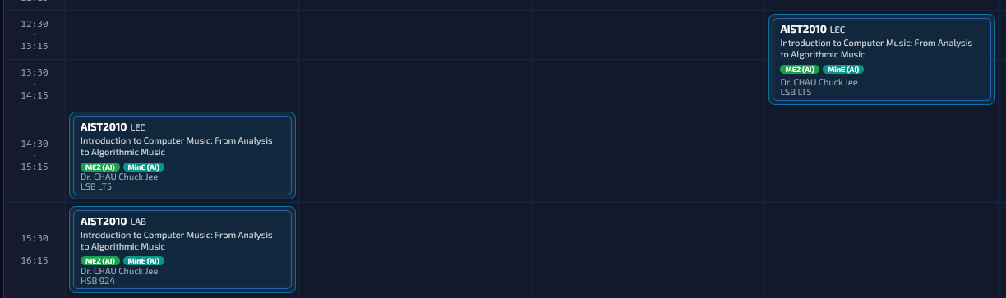
Intelligent Data Ingestion & Sanitization
Smart Conflict Handling: Automated Sectioning
e.g. CSCI3100A, CSCI3100B
e.g. TUT-1, TUT-2
Notes:
Our first core feature addresses the 'Garbage In, Garbage Out' problem.
We developed an Intelligent Ingestion Engine. It doesn't just parse CSVs/JSON; it analyzes the semantic intent of the data.
For example, if a user uploads 'CSCI3100' when it already exists, a naive system would throw a 'Duplicate Key' error. Our system checks the metadata. If the teacher is different, it infers this might be a New Section. It then prompts the user to confirm, and if approved, automatically re-indexes the course codes (creating Section A and B) to ensure database uniqueness and data integrity.

Slide 16
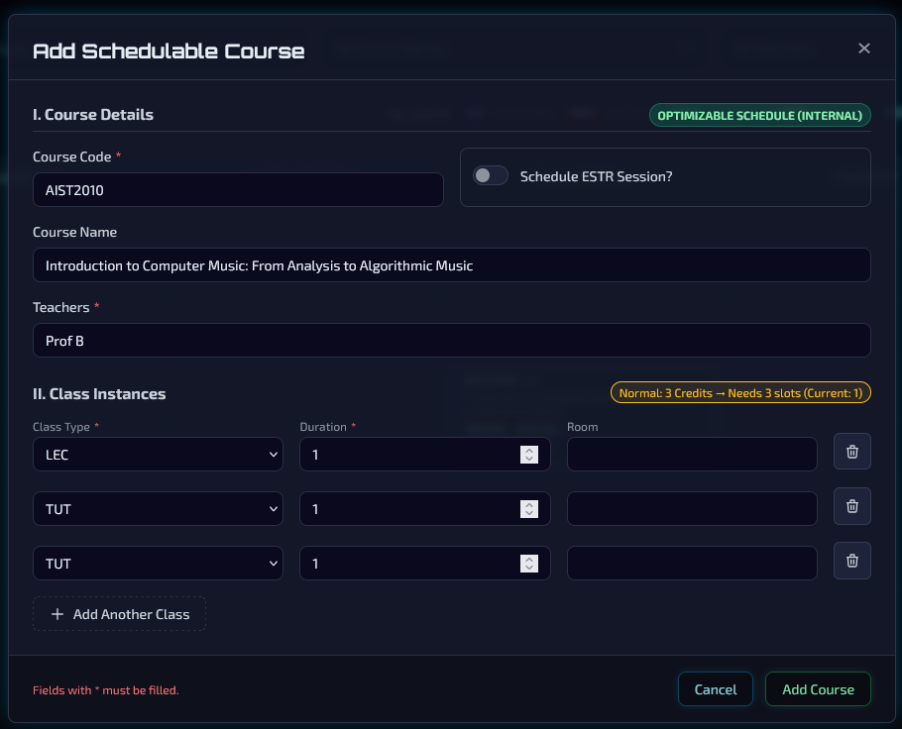
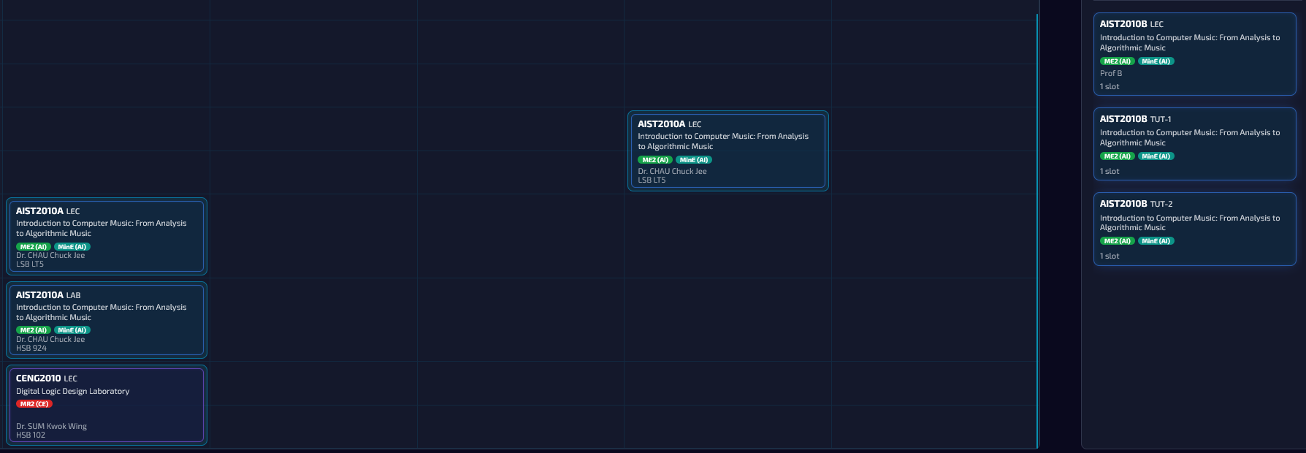
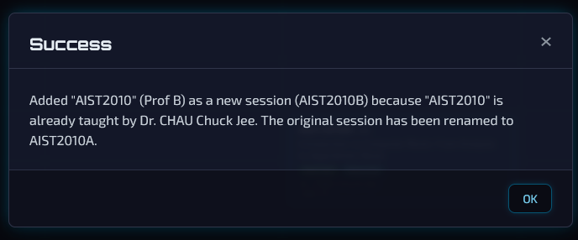
Intelligent Data Ingestion & Sanitization
Smart Conflict Handling: Automated Sectioning
e.g. CSCI3100A, CSCI3100B
e.g. TUT-1, TUT-2
Notes:
Our first core feature addresses the 'Garbage In, Garbage Out' problem.
We developed an Intelligent Ingestion Engine. It doesn't just parse CSVs/JSON; it analyzes the semantic intent of the data.
For example, if a user uploads 'CSCI3100' when it already exists, a naive system would throw a 'Duplicate Key' error. Our system checks the metadata. If the teacher is different, it infers this might be a New Section. It then prompts the user to confirm, and if approved, automatically re-indexes the course codes (creating Section A and B) to ensure database uniqueness and data integrity.

Slide 17
Automated Scheduling Engine
Input Queue
Priority Sorting
Constraint Checking
Constraints Check
Scoring & Optimization
Algorithm Strategy: Constructive Heuristic Search
Greedy strategy with look-ahead scoring to generate valid schedules
Priority Queueing ("Hardest First")
Multi-Dimensional Constraint Checking
Optimization (Soft Constraints)
Notes:
The 2nd feature is the brain of the system: The Automated Scheduling Engine.
Scheduling is theoretically NP-Hard. A brute-force approach would take eons. Instead, we implemented a Constructive Heuristic Algorithm (src/services/scheduler.ts) that mimics how a human expert thinks, but with computational speed.
First, we don't schedule randomly. We use a Priority Queue. We sort all classes based on 'Difficulty.' We place Lectures before Tutorials, Long Durations before short ones, and Senior Level courses first. This strategy minimizes grid fragmentation.
For every class, the engine scans the grid. It first filters for Hard Constraints—is the teacher free? Is the room empty? Does this clash with the Year 3 Cohort?
If multiple slots are valid, we run a Scoring Function to pick the best one. This is where we encoded CSE-specific logic. We added a heuristic for ESTR Adjacency. The algorithm actively 'hunts' for slots next to a parent lecture to place the corresponding Elite tutorial. This creates a compact, student-friendly timetable automatically

Slide 18
Automated Scheduling Engine
Notes:
First, we don't schedule randomly. We use a Priority Queue. We sort all classes based on 'Difficulty.' We place Lectures before Tutorials, Long Durations before short ones, and Senior Level courses first. This strategy minimizes grid fragmentation.
For every class, the engine scans the grid. It first filters for Hard Constraints.
If multiple slots are valid, we run a Scoring Function to pick the best one.
This is where we encoded CSE-specific logic. We added a heuristic for ESTR Adjacency. The algorithm actively 'hunts' for slots next to a parent lecture to place the corresponding Elite tutorial. This creates a compact, student-friendly timetable automatically

Slide 19
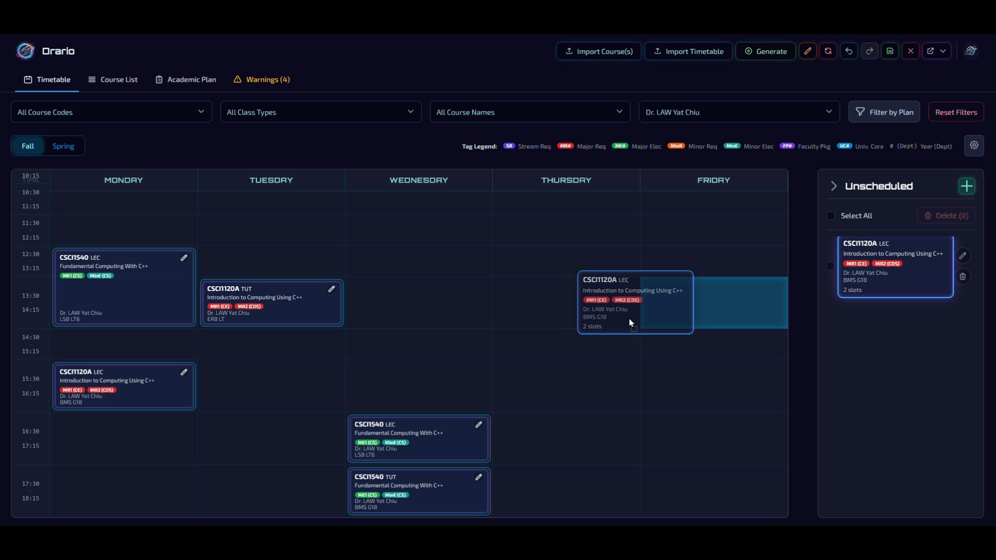
Interactive Workspace & Real-Time Logic
Collision Detection

Slide 20
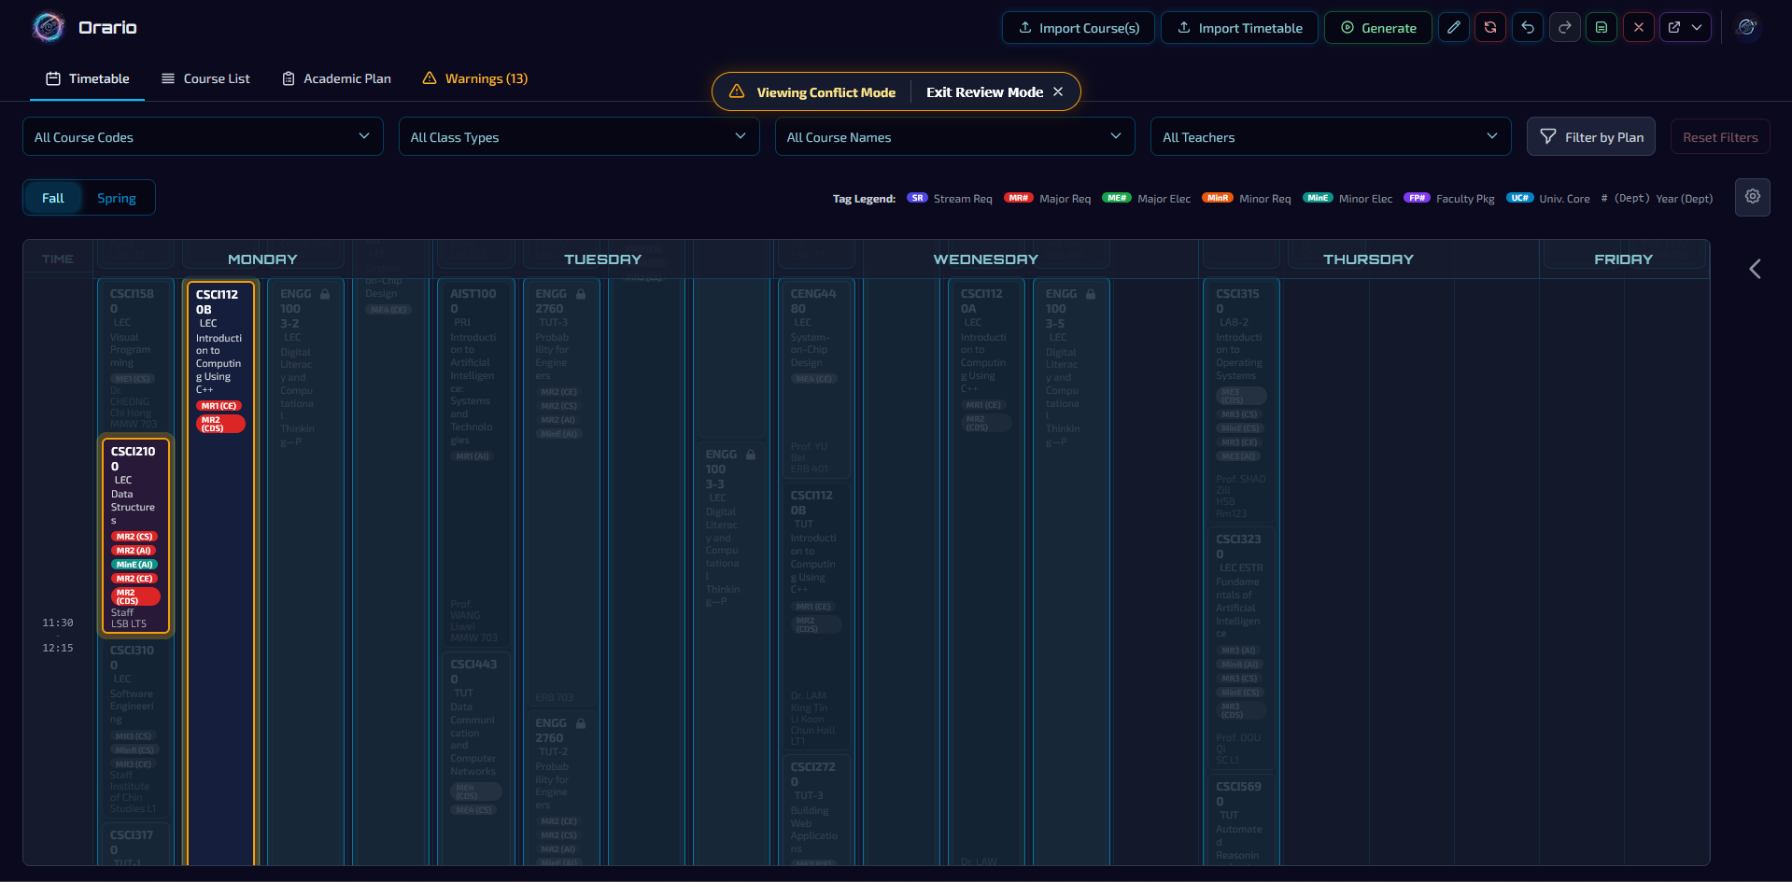
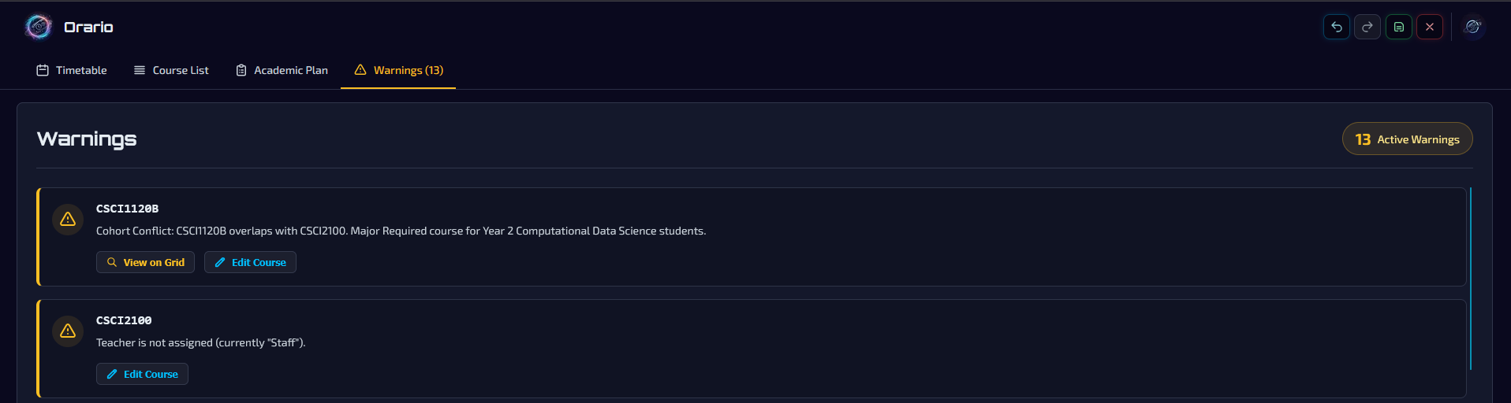
Interactive Workspace & Real-Time Logic
Conflict View
Notes:
Feature 3 is where the human interaction happens: The Interactive Workspace.
We realized that automation gets you 90% of the way there, but the last 10% always requires human adjustment. To support this, we built a high-performance Drag-and-Drop interface using React DnD.

Slide 21
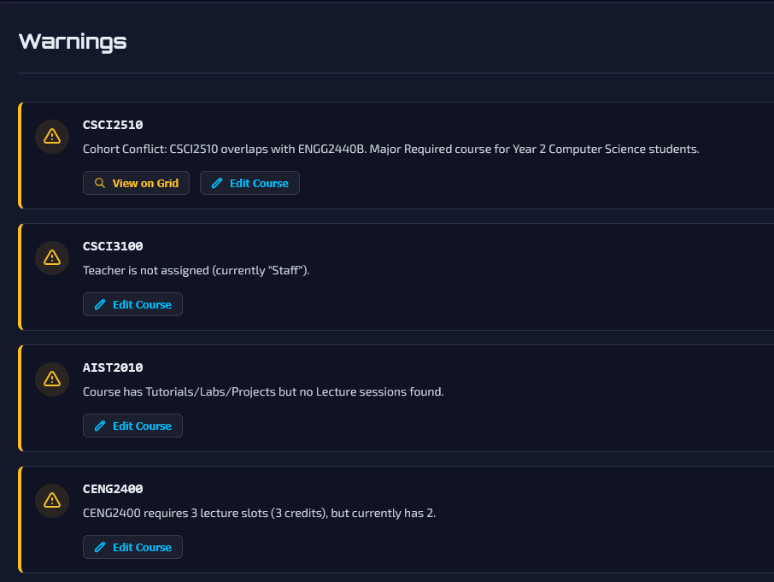
Safeguards & Output
The "Warning System"
Credit Integrity
Teacher validation
Component integrity
Student cohort conflicts

Slide 22
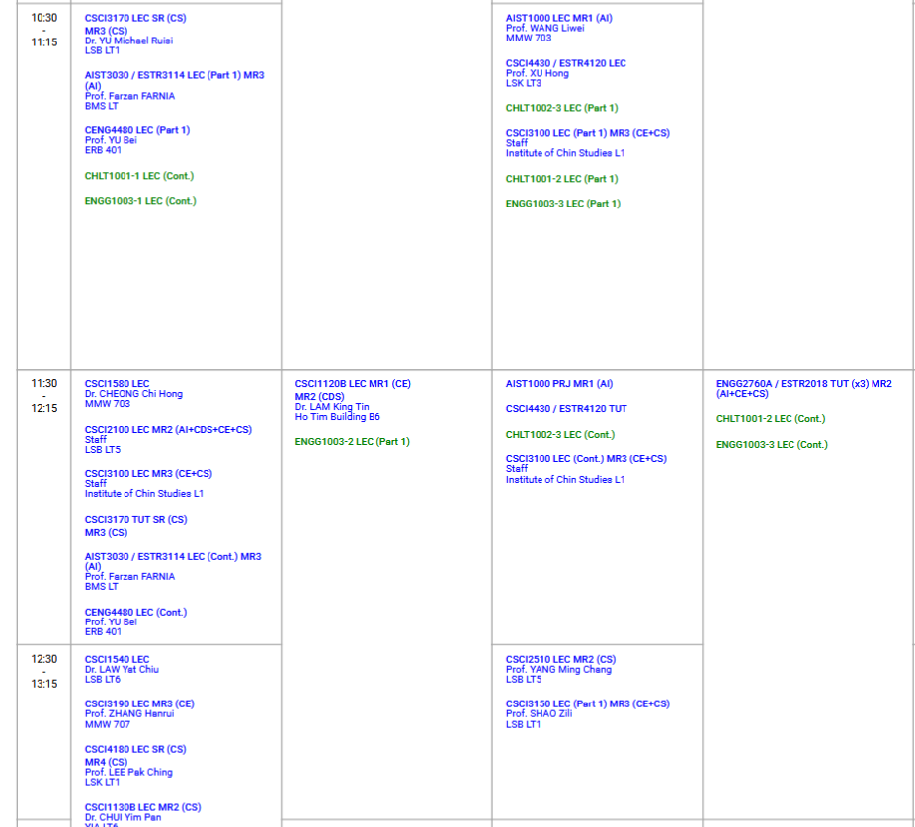
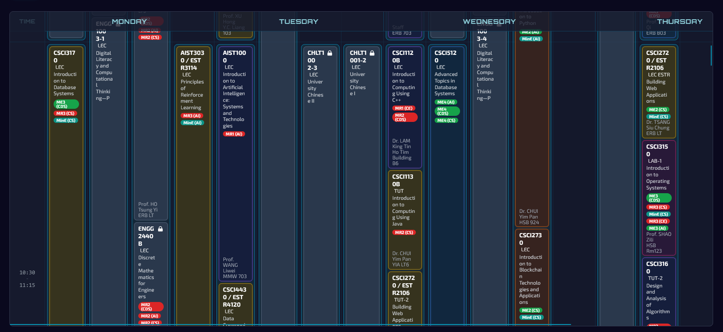
Safeguards & Output
Algorithmic PDF Generation
Custom Bin-Packing Algorithm

Slide 23
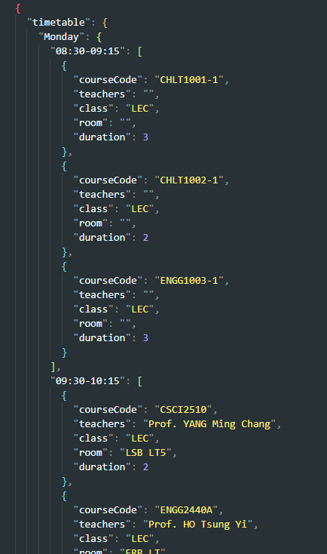
Safeguards & Output
Export timetable as .JSON

Slide 24
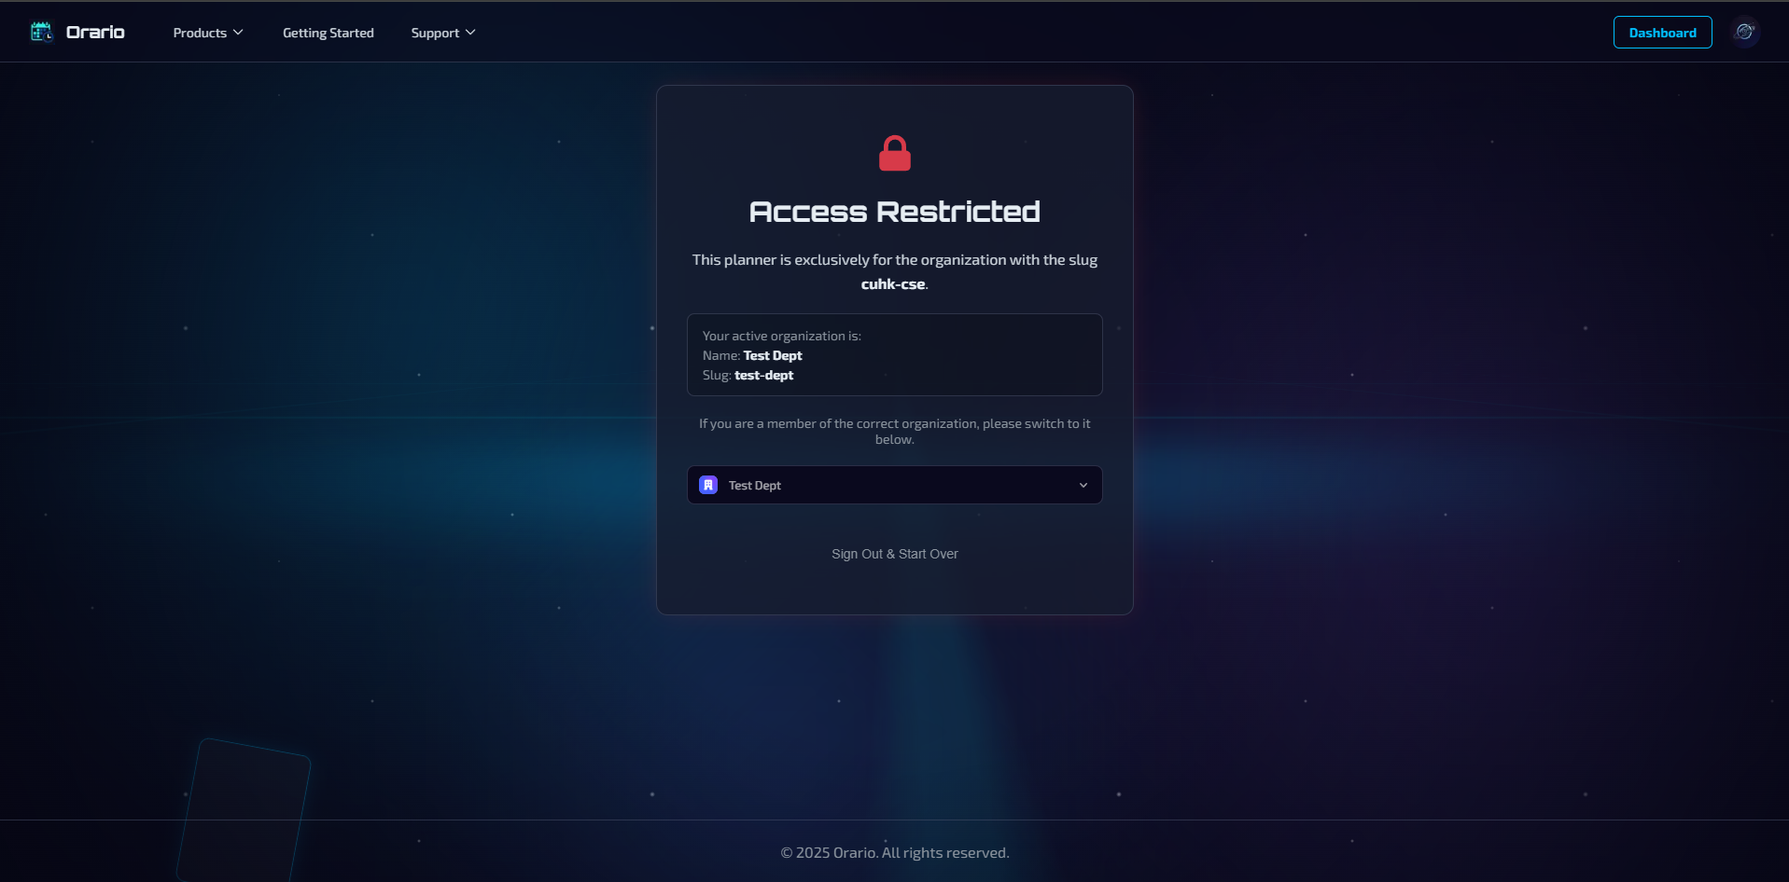
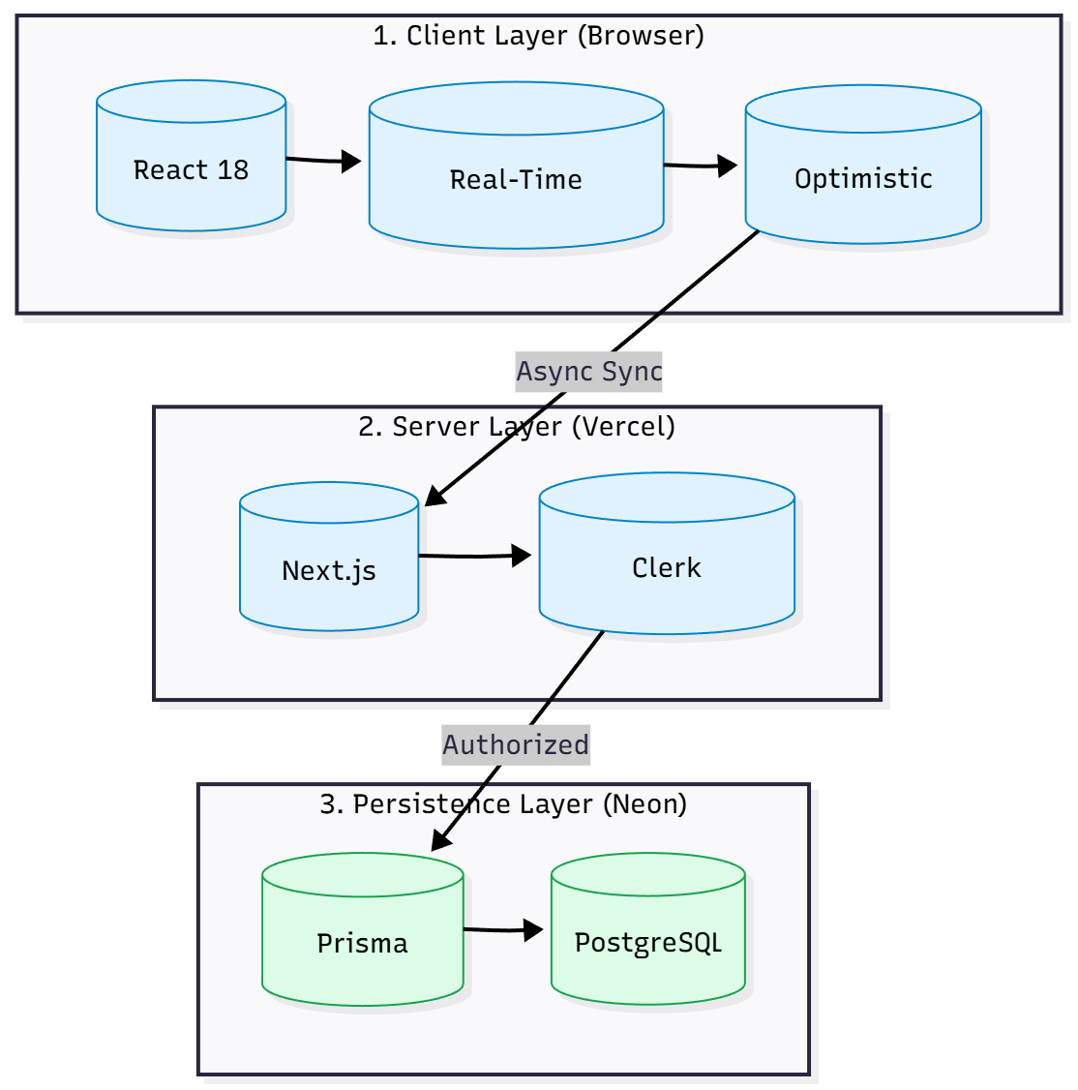
Security & Access Control
Organization-Based Multi-Tenancy
Role-Based Access Control (RBAC)
Owner: Organization control
Admin: Scheduling control
Member: Read-Only access

Slide 25
Project Achievements
Full-Stack Implementation
Deployed a responsive Next.js 14 application with Serverless PostgreSQL
Algorithmic Core
Developed the Constructive Heuristic Scheduler and PDF Bin-Packing engine
Enterprise Security
Integrated Clerk for Multi-Tenant Authentication
Ready for Use
Modeled complex department constraints

Slide 26
ROADMAP
Product Suite Expansion
Academic Edition
Enterprise Edition
Personal Edition
Advanced Architecture (Technical Deep Dive)
Concurrent Collaborative Editing
Master Data Management
Production Readiness
Full Application Testing
Notes:
Next term, we are moving from a single-user tool to a collaborative ecosystem.
First, we are expanding the product line. We will launch an Academic Edition for general schools, an Enterprise Edition for business resources, and a Personal Edition for students. Crucially, the Personal planner will integrate Advanced Intelligence to analyze user productivity habits.
Second, we are tackling two major engineering challenges:
Concurrent Collaboration: We plan to implement WebSockets to support real-time, multi-user editing, solving the complex problem of state synchronization.
Master Data Management: We will refactor the database to enforce strict referential integrity for all resources.
Finally, we will conduct Full Application Testing to ensure the platform is production-ready.

Slide 27
System Demonstration

Slide 28
THANK YOU
Q&A

Slide 29
APPENDIX

Slide 30
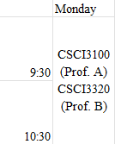
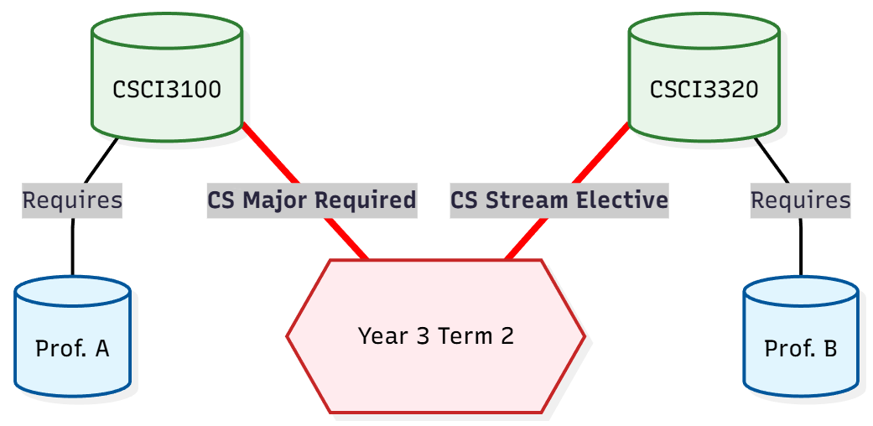
The Problem: Scheduling Dilemma
The Administrative Bottleneck
Current process relies on manual data entry into spreadsheet
As course offerings scale, search space becomes unmanageable for human intuition
Data Integrity Risks
Spreadsheets lack referential integrity to track hidden dependencies
Risk of time conflicts that are only detected after publication
Cost vs. Value
Existing SaaS is either Generic (lacks CSE constraints) or Enterprise ERP (US$500+/yr)
Notes:
3 main challenges:
Data Integrity: Spreadsheets lack the referential integrity to see these 'Silent Failures.’
Algorithmic Complexity: Our department manages curricula for 4 different Majors (CS, CE, AIST, CDS). Humans simply cannot calculate hundreds of cohort combinations against every time slot to prevent these clashes.
Cost & Value: Commercial tools are expensive ($500/yr) yet too generic to handle these specific stream constraints.

Slide 31
Our Solution: Orario
A Domain-Specific, Multi-Tenant Scheduling
Automated Intelligence
Replaces manual entry with a Constructive Heuristic Algorithm
Solves the constraint problem in seconds
Enforced Data Integrity
Real-Time Validation: Instantly flags teacher clashes and "Hidden" student cohort conflicts (Major vs. Stream vs. University Core) during drag-and-drop
Coupled Entities: Natively handles CSE-specific logic, ensuring ESTR streams remain synchronized with parent lectures
Scalable Architecture
Multi-Tenant SaaS: Organization-based data isolation allow scaling beyond CSE to other departments
Zero Licensing Cost: A self-sufficient, custom-built solution
Notes:
Orario is not just a digital calendar; it is a Domain-Specific Scheduling Platform designed to bridge the gap between manual spreadsheets and expensive enterprise software.
Automated Intelligence: Instead of relying on human intuition, we implemented a Constructive Heuristic Algorithm. It automatically solves the combinatorial puzzle, prioritizing difficult constraints like Room Capacity and Faculty Packages first.
Enforced Integrity: Unlike a spreadsheet, Orario has a 'Brain.' It runs Real-Time Validation on every interaction. If a clerk tries to move a class that conflicts with a specific Student Stream (like the AI stream example we just saw), the system warns it immediately. It also natively understands complex relationships, keeping ESTR courses strictly coupled to their parent lectures.
Scalable Architecture: We built this as a Multi-Tenant web application. This means while it is tailored for CSE today, the architecture is ready to serve Physics, Math, or Engineering faculties tomorrow with strict data isolation."

Slide 32
Technical Stack
Why Typescript?
Scheduling involves complex, nested data structures: TimeSlot, ClassInfo, Cohort
Strict typing prevents runtime errors in the heuristic algorithm
Why SQL (Postgres) over NoSQL?
Scheduling is inherently Relational: Users, Orgs, Courses, Constraints
Need strict schema enforcement and ACID compliance, which MongoDB lacks
Why Next.js App Router?
Hybrid Architecture: Uses Server Components for data fetching (Security) and Client Components for the interactive Drag-and-Drop Grid (Interactivity)
Why Clerk?
Native support for Multi-Tenant Organizations. It handles the security infrastructure so we can focus on the scheduling engine
Notes:
To build a system capable of handling this complexity, we chose a stack focused on Type Safety and Relational Integrity
The entire project is built in TypeScript since the scheduling algorithms rely on complex, nested data structures. By enforcing strict static typing, we catch logic errors at compile time, ensuring the scheduler doesn't crash when processing thousands of time slots.
For data, we chose PostgreSQL managed via Prisma ORM. We deliberately rejected NoSQL solutions like MongoDB. Because academic data is highly relational. Courses belong to Departments, which belong to Organizations. We need strict referential integrity to prevent ‘left-over' classes or invalid schedules. Prisma ensures that our database schema and our frontend types are always 100% in sync.
We utilize Next.js 14. This allows a hybrid architecture. We use Server Components to securely fetch data behind the firewall, and Client Components to render the high-performance, interactive Drag-and-Drop grid you see in the browser.
Finally, Clerk handles our Authentication. Crucially, we use Clerk's Organization feature to enforce Multi-Tenancy. This ensures that a Physics department admin can never accidentally access Computer Science data, enforcing isolation at the middleware level."

Slide 33
System Architecture
Cloud-Native & Serverless
Hosted on Vercel Edge Network. No cold starts, automatic scaling
Client-Side Logic: Validation (findConflict) runs in the browser for zero-latency feedback
Server-Side Logic: Data persistence and security checks run on Node.js
Strict Multi-Tenancy
Data isolation enforced at the database level via organizationId
Middleware intercepts every request to verify Organization Context (cuhk-cse)
Hybrid State Management
Optimistic UI: The grid updates instantly when you drag a class
Lazy Sync: Background synchronization pushes changes to PostgreSQL via Prisma transactions involves complex, nested data structures: TimeSlot, ClassInfo, Cohort
Strict typing prevents runtime errors in the heuristic algorithm
33
Notes:
Our architecture follows a Hybrid Client-Server Model.
To ensure a responsive 'App-like' feel, we moved the heavy lifting—Conflict Detection and Validation—to the Client Side. When you drag a class, the browser calculates the geometry of the time slot instantly. This gives the user zero-latency feedback.
Once a move is valid, we use an Optimistic UI update and trigger an asynchronous sync to our Serverless Backend on Vercel.
Here, Clerk Middleware intercepts the request to enforce security. It checks: 'Is this user an Admin?' and 'Do they belong to the requested Organization?'. Only then does Prisma execute the transaction against the PostgreSQL database.
This separation ensures the app is fast for the user, but strictly secure and consistent on the server.

Slide 34
Intelligent Data Ingestion & Sanitization
Schema Validation
Strict Regex enforcement for Course Codes and Time Formats during JSON/CSV parsing.
Semantic Duplicate Detection
The system identifies inputs that are semantically similar (same code) but structurally different (different teacher/duration).
Intent Resolution Engine
Smart Conflict Handling: If a new CSCI3100 is uploaded with a different teacher than the existing one, the system flags it as a potential new session.
Automated Sectioning: Automatically generates session suffixes (e.g., CSCI3100A, CSCI3100B) to resolve ID collisions without user friction.
Notes:
Our first core feature addresses the 'Garbage In, Garbage Out' problem.
We developed an Intelligent Ingestion Engine. It doesn't just parse CSVs/JSON; it analyzes the semantic intent of the data.
For example, if a user uploads 'CSCI3100' when it already exists, a naive system would throw a 'Duplicate Key' error. Our system checks the metadata. If the teacher is different, it infers this might be a New Section. It then prompts the user to confirm, and if approved, automatically re-indexes the course codes (creating Section A and B) to ensure database uniqueness and data integrity.

Slide 35
Automated Scheduling Engine
Input Queue
Priority Sorting
Constraint Checking
Constraints Check
Scoring & Optimization
Algorithm Strategy: Constructive Heuristic Search
Greedy strategy with look-ahead scoring to generate valid schedules
Step 1: Priority Queueing ("Hardest First")
Classes are sorted by "Difficulty" to prevent fragmentation:
Constraint Tightness: Lectures (LEC) are placed before Tutorials (TUT)
Duration: Long blocks (3-hr) before short blocks (1-hr)
Level: Senior courses (4000+) before Junior courses
Step 2: Multi-Dimensional Constraint Checking
Validate Hard Constraints (Teacher Occupancy, Cohort Collision) using lookup maps
Step 3: Optimization (Soft Constraints)
Workload Balancing: Penalizes days with high density.
ESTR Adjacency: Awards bonus points for placing Elite tutorials immediately adjacent to parent lectures (minimizing student gaps)
Notes:
The 2nd feature is the brain of the system: The Automated Scheduling Engine.
Scheduling is theoretically NP-Hard. A brute-force approach would take eons. Instead, we implemented a Constructive Heuristic Algorithm (src/services/scheduler.ts) that mimics how a human expert thinks, but with computational speed.
First, we don't schedule randomly. We use a Priority Queue. We sort all classes based on 'Difficulty.' We place Lectures before Tutorials, Long Durations before short ones, and Senior Level courses first. This strategy minimizes grid fragmentation.
For every class, the engine scans the grid. It first filters for Hard Constraints—is the teacher free? Is the room empty? Does this clash with the Year 3 Cohort?
If multiple slots are valid, we run a Scoring Function to pick the best one. This is where we encoded CSE-specific logic. We added a heuristic for ESTR Adjacency. The algorithm actively 'hunts' for slots next to a parent lecture to place the corresponding Elite tutorial. This creates a compact, student-friendly timetable automatically

Slide 36
Interactive Workspace & Real-Time Logic
Geometric Collision Detection (Client-Side):
Instead of server round-trips, we calculate time-slot intersections in the browser
Validates against 3 Dimensions: Teacher Availability, Room Capacity, and Course Self-Concurrency in lookup time
Optimistic UI Updates:
State changes reflect immediately in the React DOM for zero-latency interaction
Database synchronization happens asynchronously in the background via Prisma transactions
State Management (Command Pattern):
Maintain a deep-cloned History Stack to enable robust Undo/Redo functionality without database inconsistency
Notes:
Feature 3 is where the human interaction happens: The Interactive Workspace.
We realized that automation gets you 90% of the way there, but the last 10% always requires human adjustment. To support this, we built a high-performance Drag-and-Drop interface using React DnD.
The core technical challenge here was latency. If we validated every move on the server, the UI would feel sluggish. Instead, we implemented Geometric Collision Detection directly in the client. When you drag a card, the browser calculates vector intersections against the entire dataset in real-time. If you hover over a slot where the professor is busy, it rejects the drop instantly—zero lag.
We also implemented a Command Pattern for state management. Every action pushes a snapshot to a history stack, allowing users to Undo/Redo complex changes instantly, ensuring data safety during rapid editing

Slide 37
Safeguards & Output
The "Warning System" (Background Validator):
Runs logic checks beyond simple time conflicts
Credit Integrity: Flags if Scheduled Duration < Academic Plan Credits
Component Integrity: Detects "Orphaned" Tutorials (Missing Parent Lecture)
Algorithmic PDF Generation:
Challenge: Mapping a dynamic CSS Grid to a fixed-width A3/A4 Page
Solution: Custom Bin-Packing Algorithm
Calculate column spans and recursively fragments long classes to fit into the PDF layout without data loss
Notes:
Feature 4 focuses on reliability: Safeguards & Output
A schedule can look valid but still be broken. Our Safeguard System runs a continuous background validation loop. It detects logic errors, such as a 3-credit course only having 2 hours scheduled, or a Tutorial existing without a Lecture.
For output, we faced a unique challenge: Printing a dynamic web grid to a static PDF. We wrote a custom Bin-Packing Algorithm for the PDF generator. It analyzes overlapping blocks and calculates optimal column spans, even 'fragmenting' long classes across columns to ensure the visual output on paper matches the web interface exactly

Slide 38
Security & Access Control
Organization-Based Multi-Tenancy:
All database queries are strictly scoped by organizationId
Ensures complete data isolation between different departments (e.g MAE department cannot query CSE department’s data)
Role-Based Access Control (RBAC):
Owner/Admin: Scheduling control (Edit Timetable, Import Data, Invites)
Admin: Scheduling control (Edit Timetable, Import Data)
Member: Read-Only access (View Timetable/Course List)
Middleware Protection:
Next.js Middleware intercepts requests before they reach the database, enforcing authentication at the edge.
Notes:
Finally, Security. Since this system is designed for university-wide deployment, we implemented strict Multi-Tenancy.
Every database query is scoped by an organizationId. This guarantees that data from the CSE department is physically isolated from the Math department.
We also enforced Role-Based Access Control. Using Middleware, we verify user roles on every API call. An 'Admin' can modify the schedule, but a standard 'Member'—like a lecturer—has Read-Only access. This prevents unauthorized changes to the published timetable.

Slide 39
Project Achivements
Full-Stack Implementation
Deployed a responsive Next.js 14 application with Serverless PostgreSQL
Established a robust CI/CD pipeline via Vercel
Algorithmic Core
Developed the Constructive Heuristic Scheduler and PDF Bin-Packing engine
Implemented Intent Resolution Logic for fuzzy data ingestion
Enterprise Security
Integrated Clerk for Multi-Tenant Authentication
Enforced Role-Based Access Control at the middleware level
Domain Fidelity
Successfully modeled complex department constraints (ESTR Coupling, Cohort Requirements) that commercial tools lack

Slide 40
ROADMAP
Product Suite Expansion
Academic Edition: generalize the current settings to support non-CSE scheduling rules
Enterprise Edition: adapting the engine for Resource Allocation and Meeting Management.
Personal Edition: a student-focused planner featuring Advanced Intelligence for productivity analysis and smart study suggestions
Advanced Architecture (Technical Deep Dive)
Concurrent Collaborative Editing: allow multiple admins to edit the same schedule in real-time without race conditions by implementing WebSocket
Master Data Management: refactor string literals (e.g., Teacher Names) into strict relational entities to ensure department-wide consistency
Production Readiness
Full Application Testing: rigorous end-to-end testing pipelines to ensure stability before deployment

